Slide 1
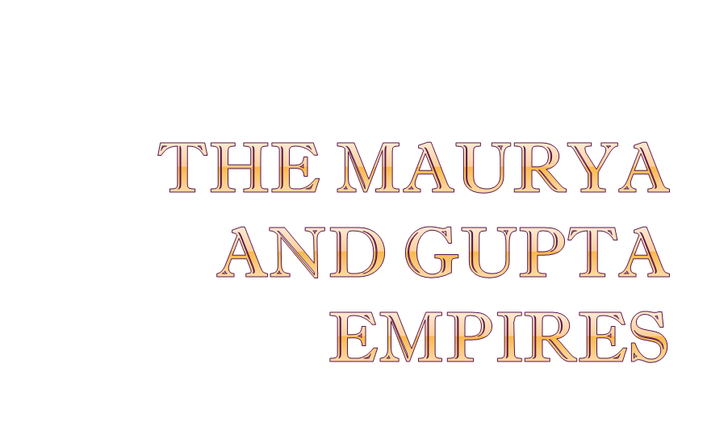

Slide 2

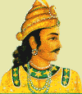
Chandragupta Mauyra’s Rule
Created a bureaucracy- a system of departments and agencies formed to carry out the work of the government.
  Divided the empire into four provinces
  Hired men to work as district officials who assessed taxes and imposed laws within these provinces
  He heavily taxed citizens to raise an army of 630,000 men and 9,000 elephants

Slide 3

Chandragupta relied on his adviser, Kautilya, who wrote guidelines for rulers called Arthasastra. It…
  Outlined strict policies designed to hold the vast territory together
  Suggested the use of spies, assassinations, secret police, and an elaborate bureaucracy

Slide 4

Secret Police were brutal, but efficient…
  Reported corruption
  Fought crime throughout empire
  Reported dissent within empire
Chandragupta was effective, but harsh, and therefore fearful of his enemies, so he…
  Hired women warriors to protect palace
  Had servants taste food for poison
  Built secret passages in his palace to escape

Slide 5

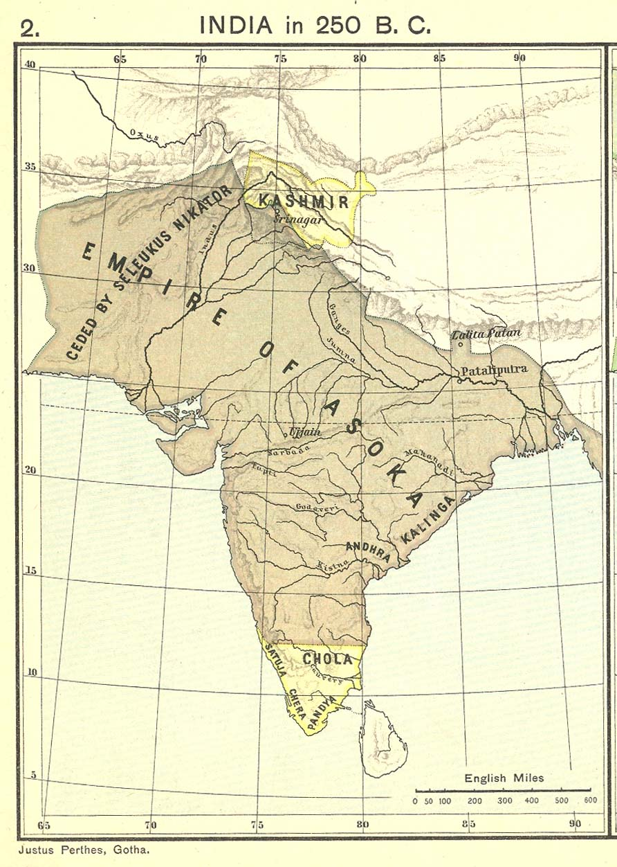
Asoka was Chandragupta’s grandson
Acquired the Deccan Region of Kalinga through military conquest
The conquest was bloody, and resulted in 100,000 soldiers killed, even more civilians
  Asoka converted to Buddhism…why?
  After seeing the death and destruction of war, he turned to a religion that promoted peace
Notes:
Asoka’s Enlightened Rule
Begins with Asoka expanding the Mauryan borders through some brutal wars—very bloody .Battle of Kalinga- 100,000 soldiers killed even more civilians
Because he is sickened by all the carnage, he looks for another answer besides fighting and finds it in Buddhism—he then converts.

Slide 6

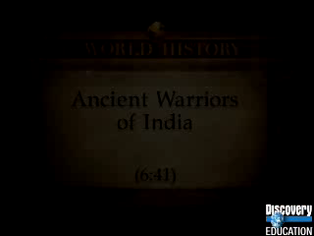

Slide 7

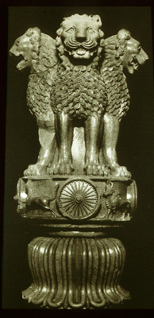
Ruled by Buddha’s teaching, “peace to all beings”
Had huge stone pillars inscribed with new policies - Rock Edicts
  Treated subjects humanely
  and fairly
  Encouraged religious toleration
  Had extensive roads constructed
  (9 miles had wells dug and rest homes
  built, included fruit trees along road)
  Constructed hospitals
Notes:
He issues Rock Edicts---laws stressing concern for other human beings
Also began free hospitals, veterinary clinics, and built rest houses along the road systems.

Slide 8

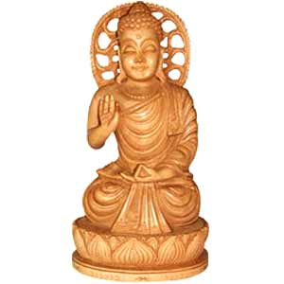
Encouraged vegetarian lifestyle
Limited Hindu animal sacrifices
Sent missionaries to China and Sri Lanka
  Paved way for Buddhism to Asia
  Unfortunately, after Asoka’s death the empire crumbled due to lack of unification.

Slide 9

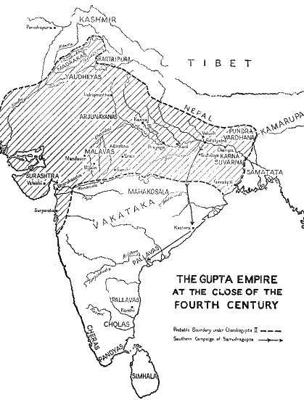
MAURYA
GUPTA
Notes:
Established by Chandragupta I in 310 BCE---it lasted 200 years
Mauryan or Gupta Empires, which was bigger?—Mauryan—the Gupta never conquer the Indus Valley or the Deccan Plateau.
This is India’s Golden Age

Slide 10

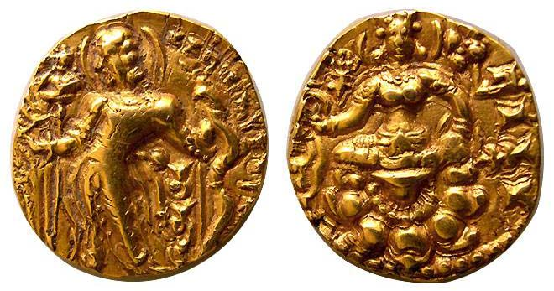
Chandra Gupta I (no relation) oversaw a great flowering of Indian Civilization…how?
  He organized a strong-central government and ensured peace and prosperity (but how?)
    Much power was left in the hands of individual leaders and city government officials
    Trade and farming flourished
Notes:
Gupta Religion:
Made Hinduism the state religion of India.
Gupta Life:
Chandragupta II ruled during the height of the empire
Gave people more freedom and less taxes---YEA!!
Wrote down rules and laws
Arranged marriage begin during this period—still around today☺

Slide 11

Prosperity under Chandra Gupta I and II recorded by visitors to India Chinese Buddhist monk Fa Hsien visits India

Slide 12

Patriarchical Lifestyle – Father is the head of the home.
Kalidasa was one of India’s greatest writers
  Shakuntala
Astronomy, Mathematics & Medicine
  Created calendar based on the sun
  7 day week – divided day into hours
  Performed surgery
  Writings included two lengthy medical guides
Created modern numerals, the concept of zero, decimal system, & pi (the 3.14 kind)
Found vaccine for smallpox
Proved earth was round
Aryabhata describes the orbit of the planets
Notes:
Gupta Achievements:
Literature—PANCHATANTRA—taught moral lessons—included fables about Sinbad, Jack and the Bean Stalk / KALIDASA—most famous playwright of India—the Shakespeare of India—wrote Shakuntala: a romantic tale of love between a king and a forest maiden.
Math: Arabic Numerals, concept of zero, decimal system, pi
Astronomy/Science—identified 7 planets—calculated the diameter of the earth/knew it was round—developed a theory of gravity,
Medicine— Found the vaccination for small pox Susruta-wrote about cleanliness and sterilization / Caroka-developed a code of ethics for physicians to follow (just like Hippocrates) / they performed surgery, used inoculations, set bones, performed plastic surgery
End of the Golden Age: Chandragupta II dies in 415 AD---empire is weakened through lack of leadership and wars—by 600 AD it is gone.

Slide 13

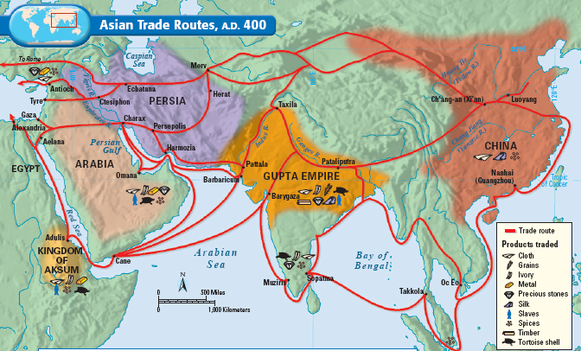
Increased trade leads to banking and cultural diffusion

Slide 14

It’s the same old story…
  Civil wars, weak rulers, and invaders undermine stability
Fractures back into the many kingdoms that existed before unification
  No new empire seen in India for nearly 1000 years

